Slide 1
The Host Gatekeeper:
Sculpting Commonalities in Symbiont Flagella
Biosynthesis Pathways

Slide 2
Overview
Broad Evolutionary Concepts
Microbial Genetics and Evolution
Model System
My Project
Notes:
Go through the overview. Then emphasize the ease of this process. Big to small

Slide 3
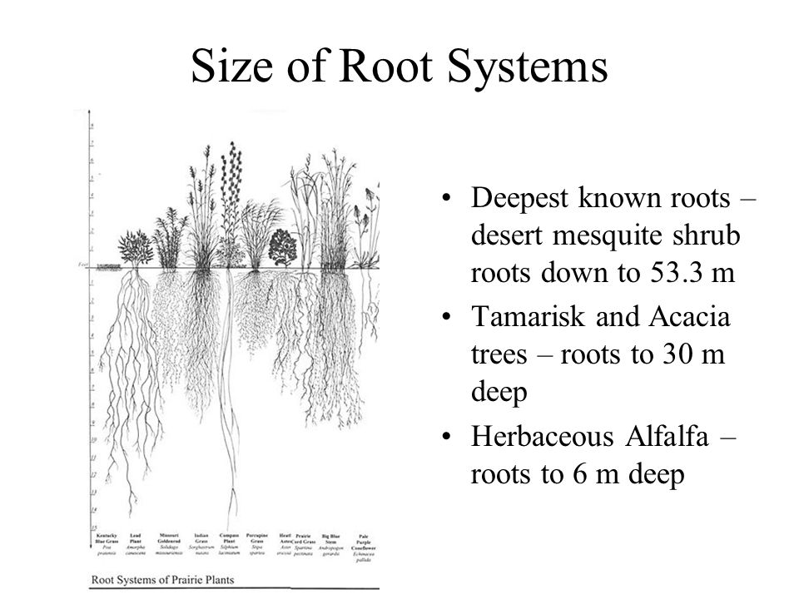
Ecological Filters Help Drive Unique Adaptations Throughout a Community
Notes:
Desert plants have longer root systems to enable more efficient micronutrient acquisition. Longer roots result in a larger surface area.

Slide 4
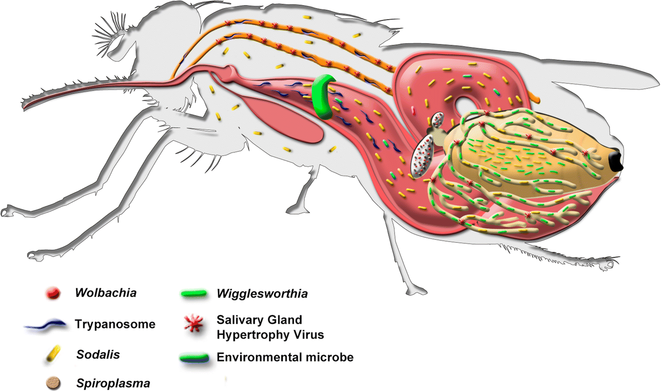
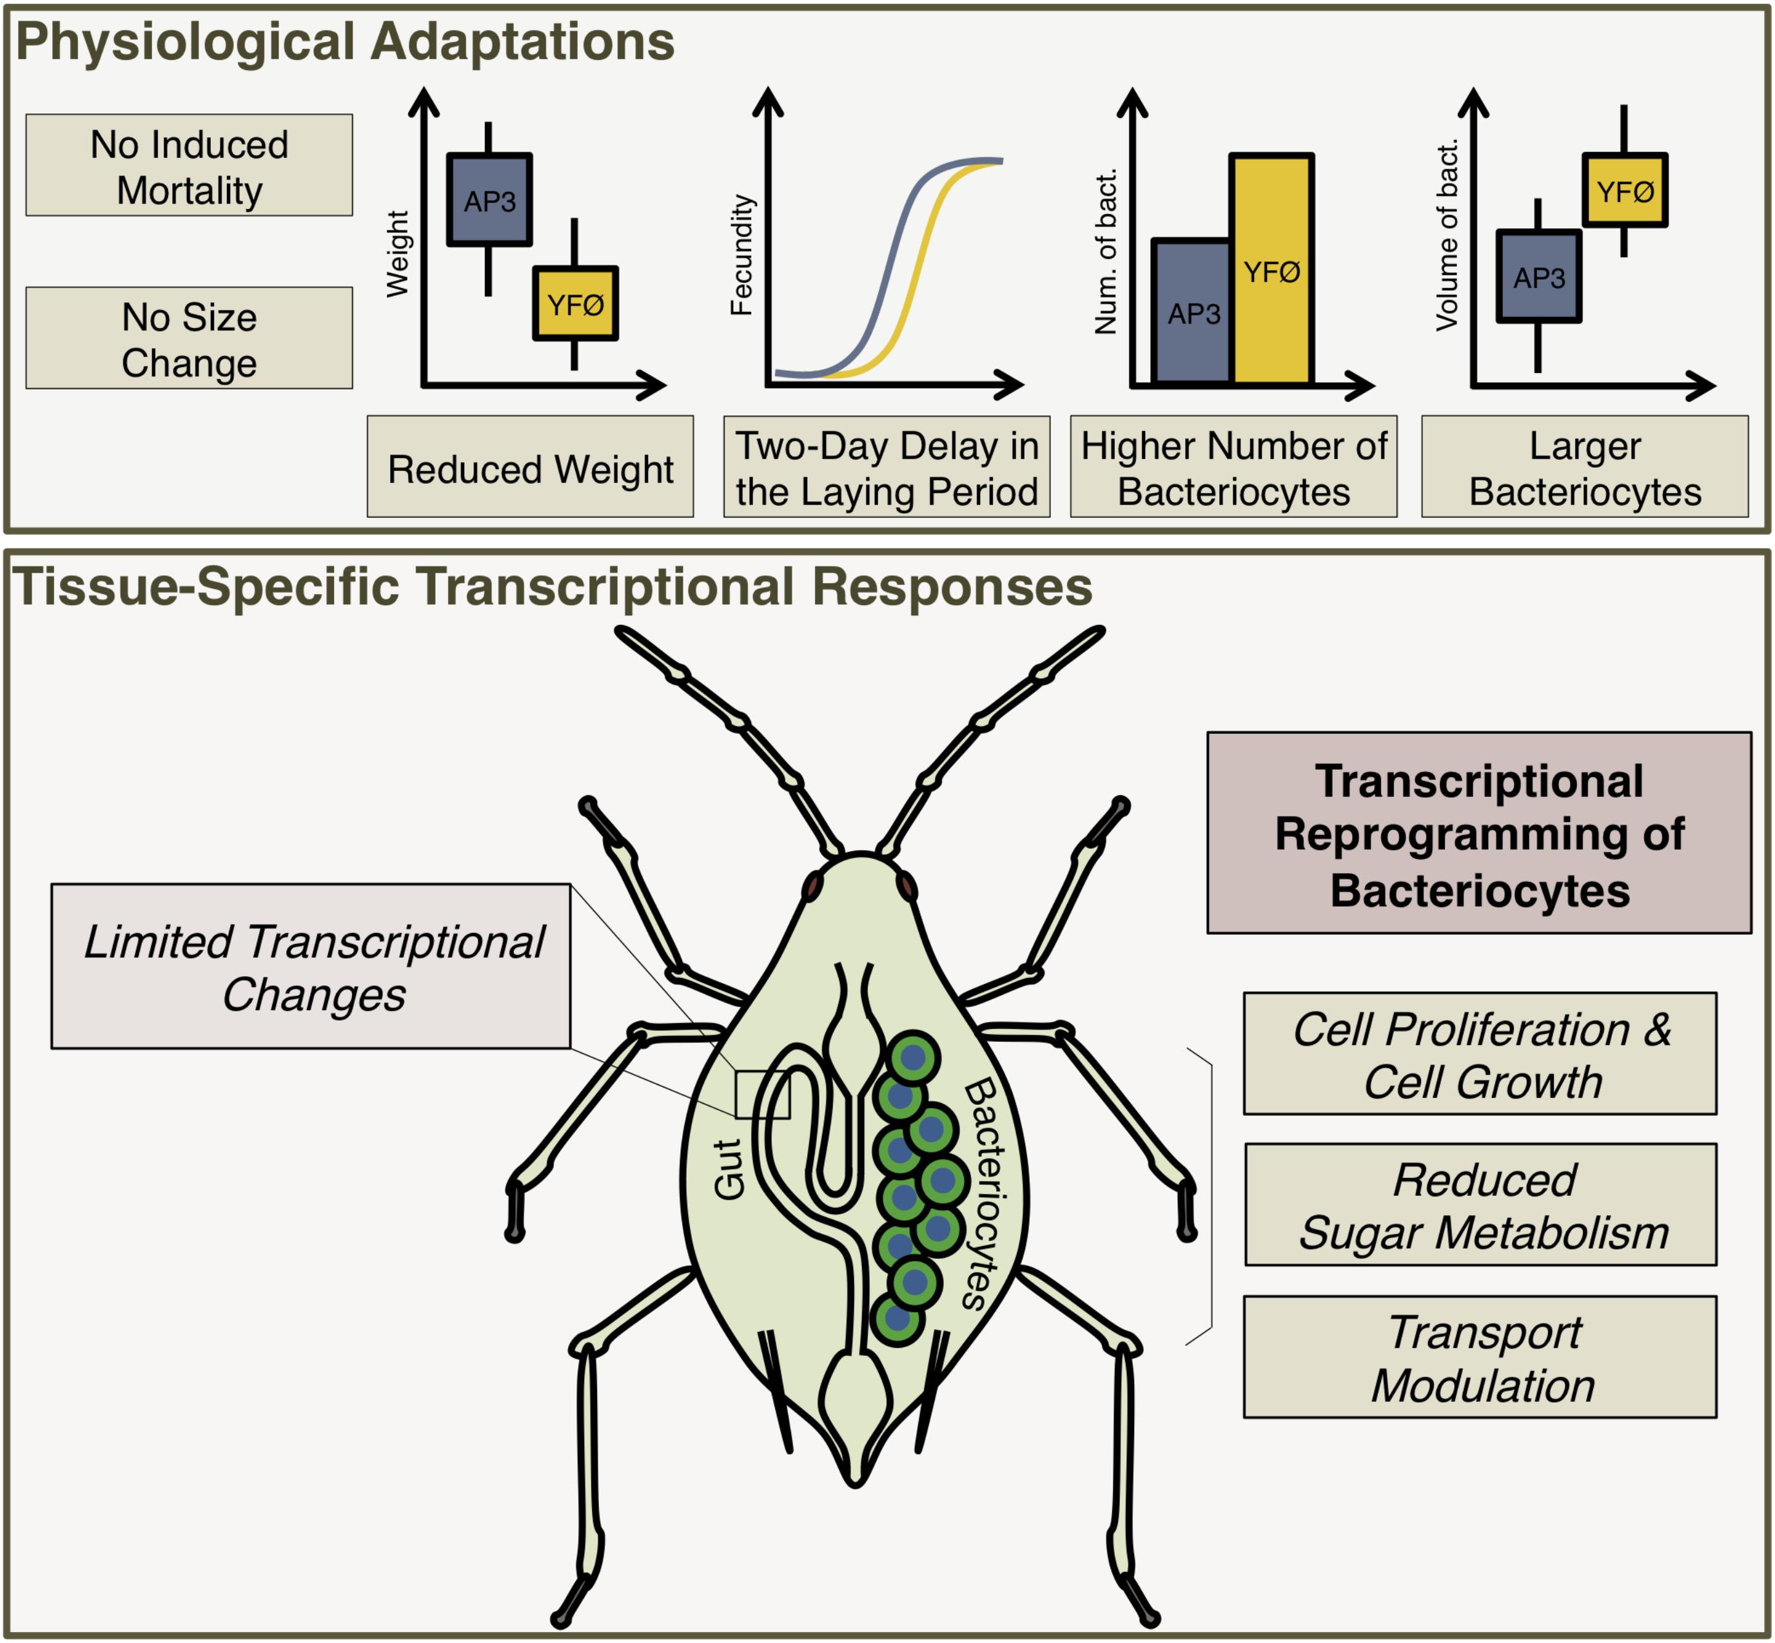
Like Macro-Organisms, Microbes Adapt to Host Environments
Host-symbiont associations can allow the host species to survive in a less hospitable ecological niche.
Symbionts, to survive, require the ability to sustain within the unique host environment to become a part of host natural microbiota.
Dynamic microbial tool-sets are essential to the establishment of a host-symbiont relationship.
Endosymbiosis is rare among multicellular organisms.
Kariithi et al 2018
Paulk et al. 2018

Slide 5
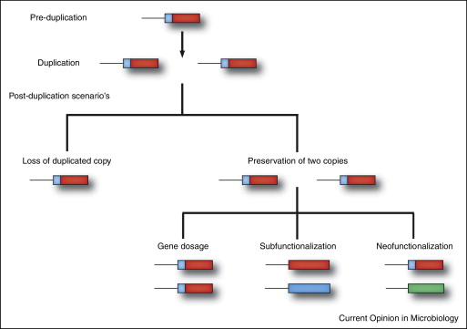
Gene Duplication
Voordeckers et al. 2015
Notes:
Microbes have several tools at there disposal to gain new phenotypes to overcome environmental filters. One method, gene duplication can result in new phenotypes that might be better suited to the new environment.

Slide 6
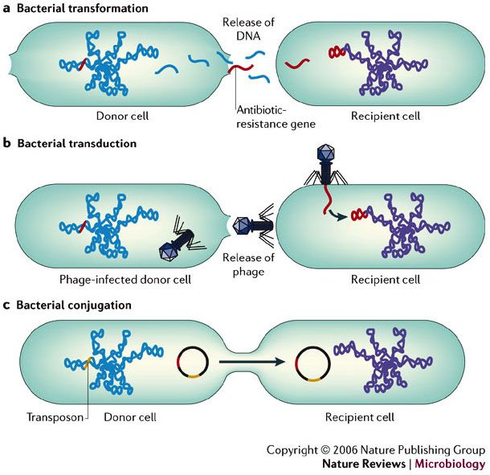
Horizontal Gene Transfer
Furuya et al 2006
Notes:
Horizontal gene transfer is another unique tool that can allow microbial organisms to adapt to new ecological conditions

Slide 7
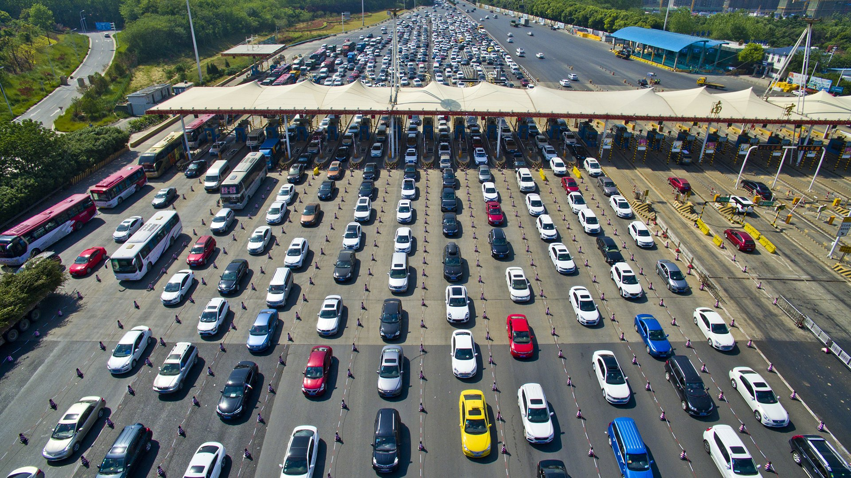
Endosymbiosis, and the Lack of New Genetic Material
Evolutionary bottleneck.
Rampant gene loss.
Increase in deleterious mutations resulting in pseudogenes.
Essential genes are selected for due to specific functions within the relationship.

Slide 8
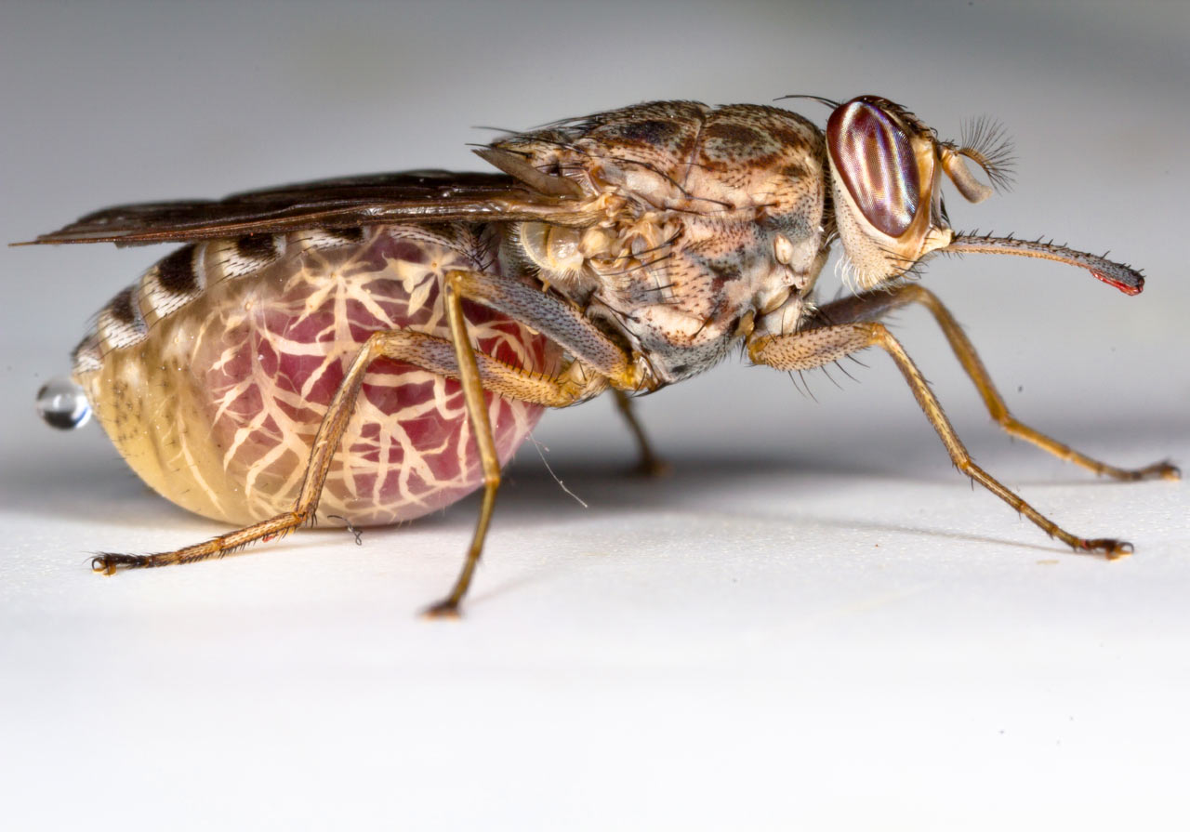
Tsetse Fly Biology
Wigglesworthia glossinidia
Known to play a role in B vitamin synthesis.
Thought to be essential for Tsetse fly survival.
Extremely old symbiosis 50-80 Mya
Sodalis glossinidius
Non essential.
More recent acquisition.
Citation: Oregon state university

Slide 9
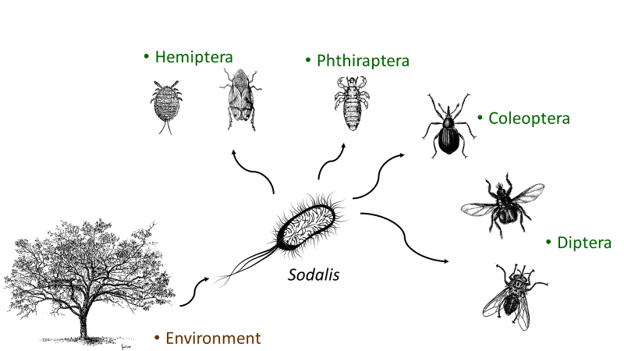
Sodalis-allied Organisms
Recent acquisition in many different hosts.
Typically secondary symbionts.
The proto-symbiont like Sodalis praecaptivus.
Notes:
Unlike Darwins finches the Sodalis-allied organisms do not posses beaks. But they do all posses flagella at some level of conservation.

Slide 10
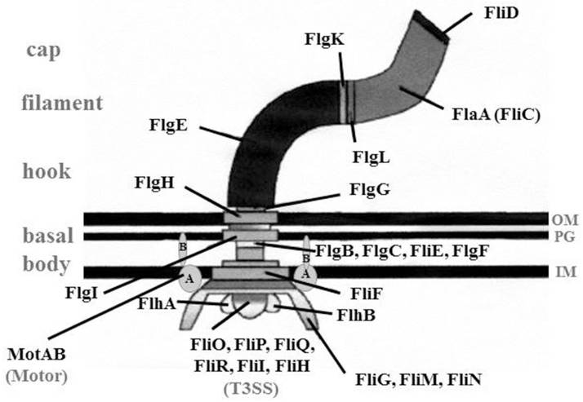
Basic Flagellar Structure
Master control | Regulators | Chaperones | Motor control complex
flhC | fliK | fliJ | fliG
flhD | fliZ | flgA | fliM
Flagellar export apparatus | fliA | flgN | fliN
flhA | flgM | fliS | flgH
flhB | Hook and filament | fliT | motA
flhE | flgE | Chemotaxis | motB
fliO | flgD | cheA | flgB
fliP | flgK | cheB | flgC
fliQ | fliC | cheW | flgF
fliR | fliD | tsr/tar | flgG
fliH |  | tap | flgJ
flil |  | cheY | flgI
 |  | cheZ | fliF
 |  | cheR | fliE
Appelt et al 2018
One of the most complex microbial machines.
Consisting of approximately 50 well conserved proteins.
The source of many secretions systems.

Slide 11
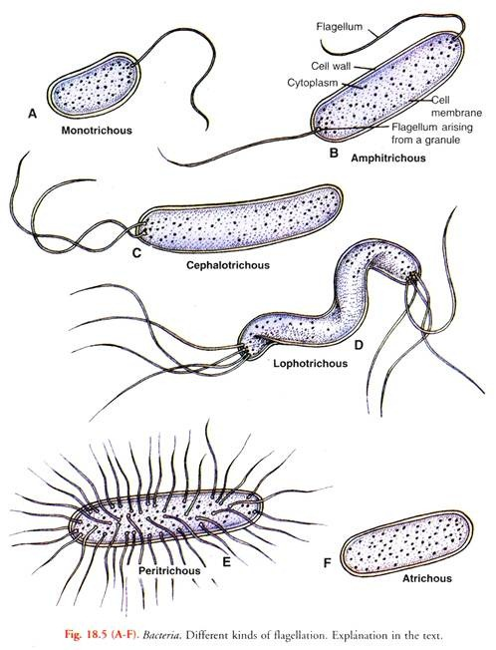
Flagella Evolution
Gene duplication events have lead to an emergence of different flagella strategies.
Individual organisms can posses different pathways within a single cell.
Many organisms use different flagella to react to different pressures.
http://www.biologydiscussion.com/bacteria/the-diagram-of-bacterial-cell-microbiology/63872

Slide 12
Why is the flagellum a good proxy for studying host filter?

Slide 13
Hypothesis
Within the tsetse fly, the two predominant bacterial symbionts have conserved a singular unique flagellar pathway necessary for habitation.
Additionally, Sodalis is in the process of losing a second flagellar synthesis pathway, in a very different way than other Sodalis-allied symbionts, as it concurrently selects for another.

Slide 14
Aim 1
To phylogenetically characterize flagellar genes within tsetse microbiota in comparison to other Proteobacteria.
H
The flagellar clusters of Sodalis and Wigglesworthia have evolved from the same origin and have been conserved due to a shared host and equivalent selection pressures.

Slide 15
Well Conserved fliE-R Operon

Slide 16
There is synteny between Sodalis glossinidius, Wigglesworthia species, and Sodalis praecaptivus

Slide 17
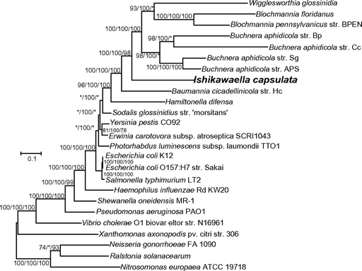
Wigglesworthia not directly related Sodalis glossinidius
Published 50 ribosomal gene tree. likelihood/Bayesian/neighbor joining. With numbers representing bootstraps/posterior probability.
Ishikawaella capsulata
Nikoh et al 2011
Notes:
Published 50 ribosomal genes likelihood/Bayesian/neighbor joining bootstraps/posterior probability.

Slide 18
Buchnera will be very important as it is the organism that separates Sodalis from Wigglesworthia
Ishikawaella capsulata
Nikoh et al 2011
Notes:
Published 50 ribosomal genes likelihood/Bayesian/neighbor joining bootstraps/posterior probability.

Slide 19
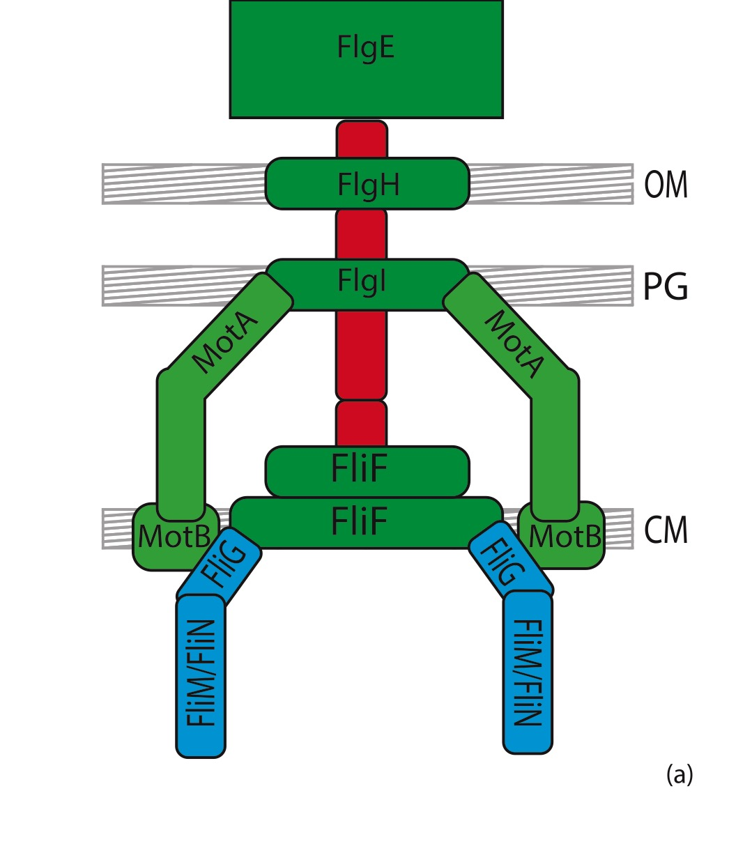
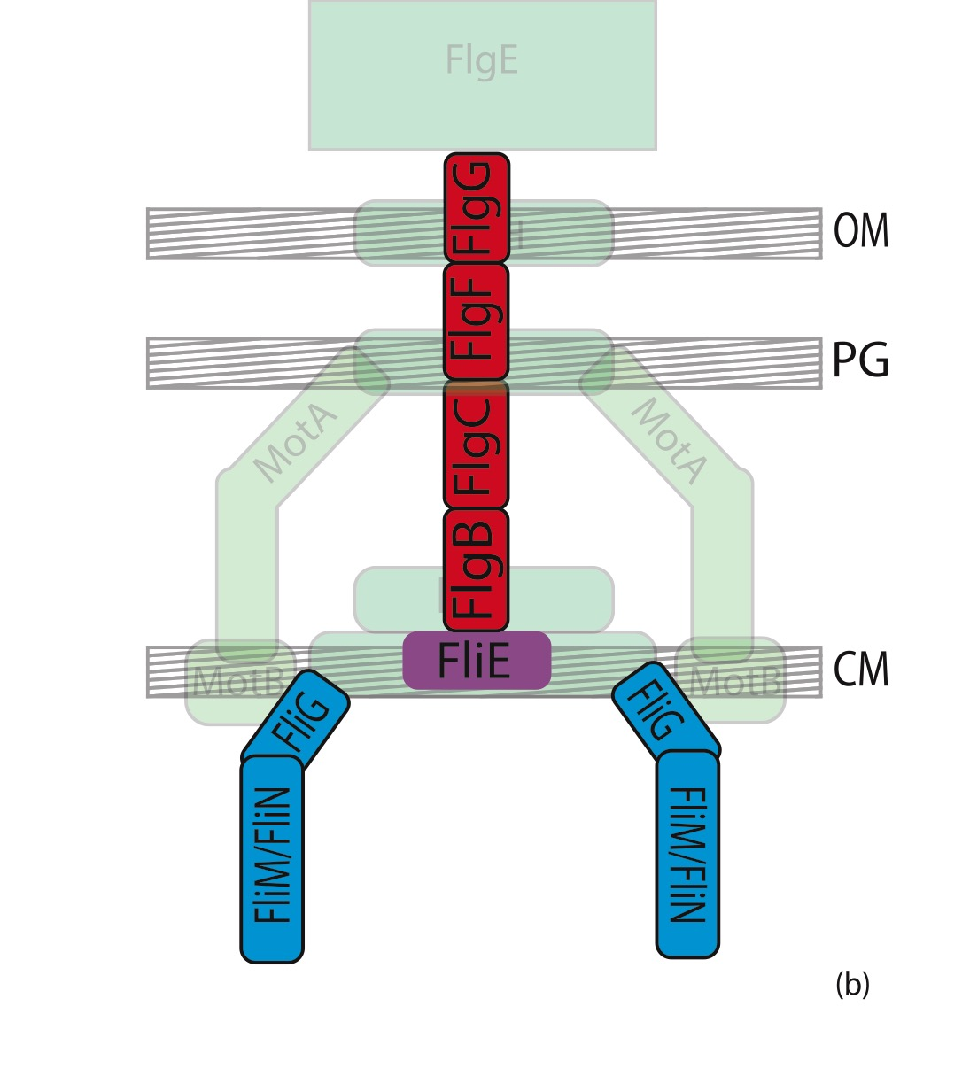
Well conserved within Buchnera, Wigglesworthia, and Sodalis
External view
Cross-section
Notes:
Basal Body and Motor control complex. Conserved within buchnera wigglesworthia and sodalis

Slide 20
Expected phylogeny which would support hypothesis
Notes:
Tree demonstrating my hypothesis of expected relationship between Praecaptivus, Wigglesworthia, and Glossindius Add caption referencing nikkoh et al 2011

Slide 21
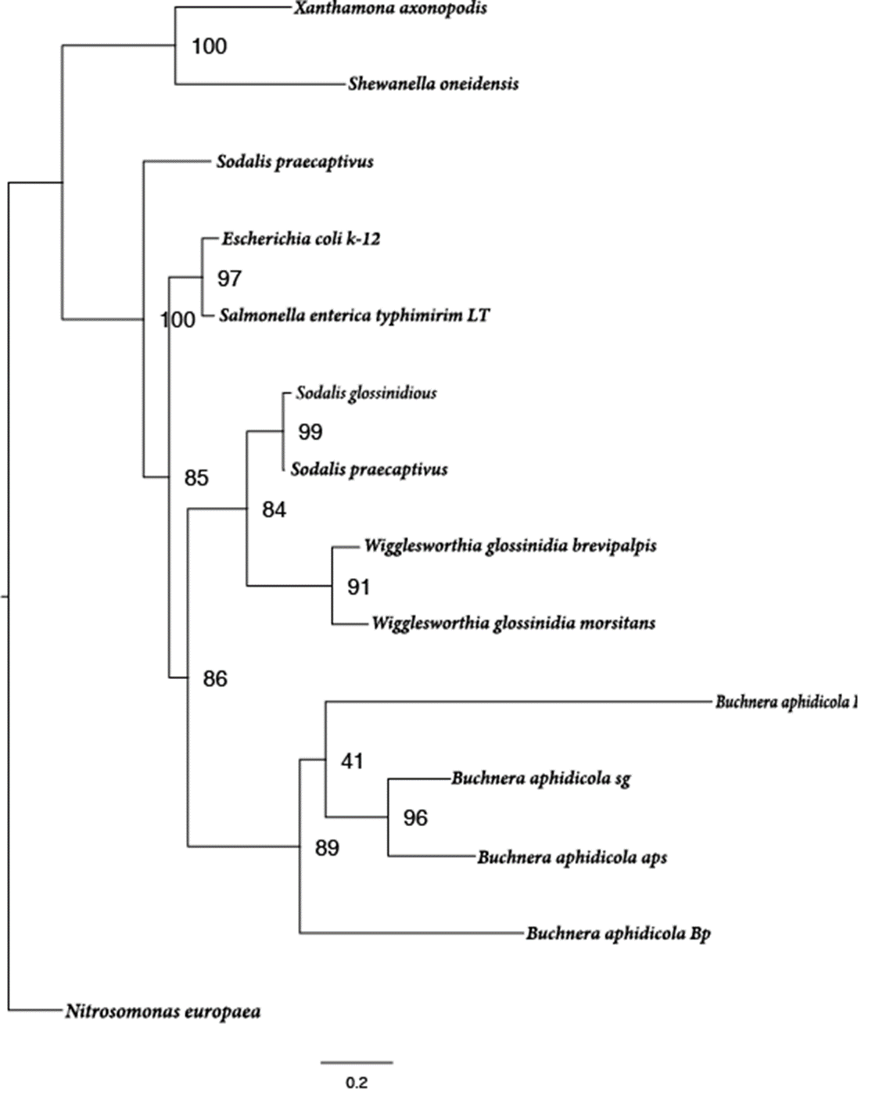
FlgI RAxML protein tree. 1000 Bootstraps.
Blossum62

Slide 22
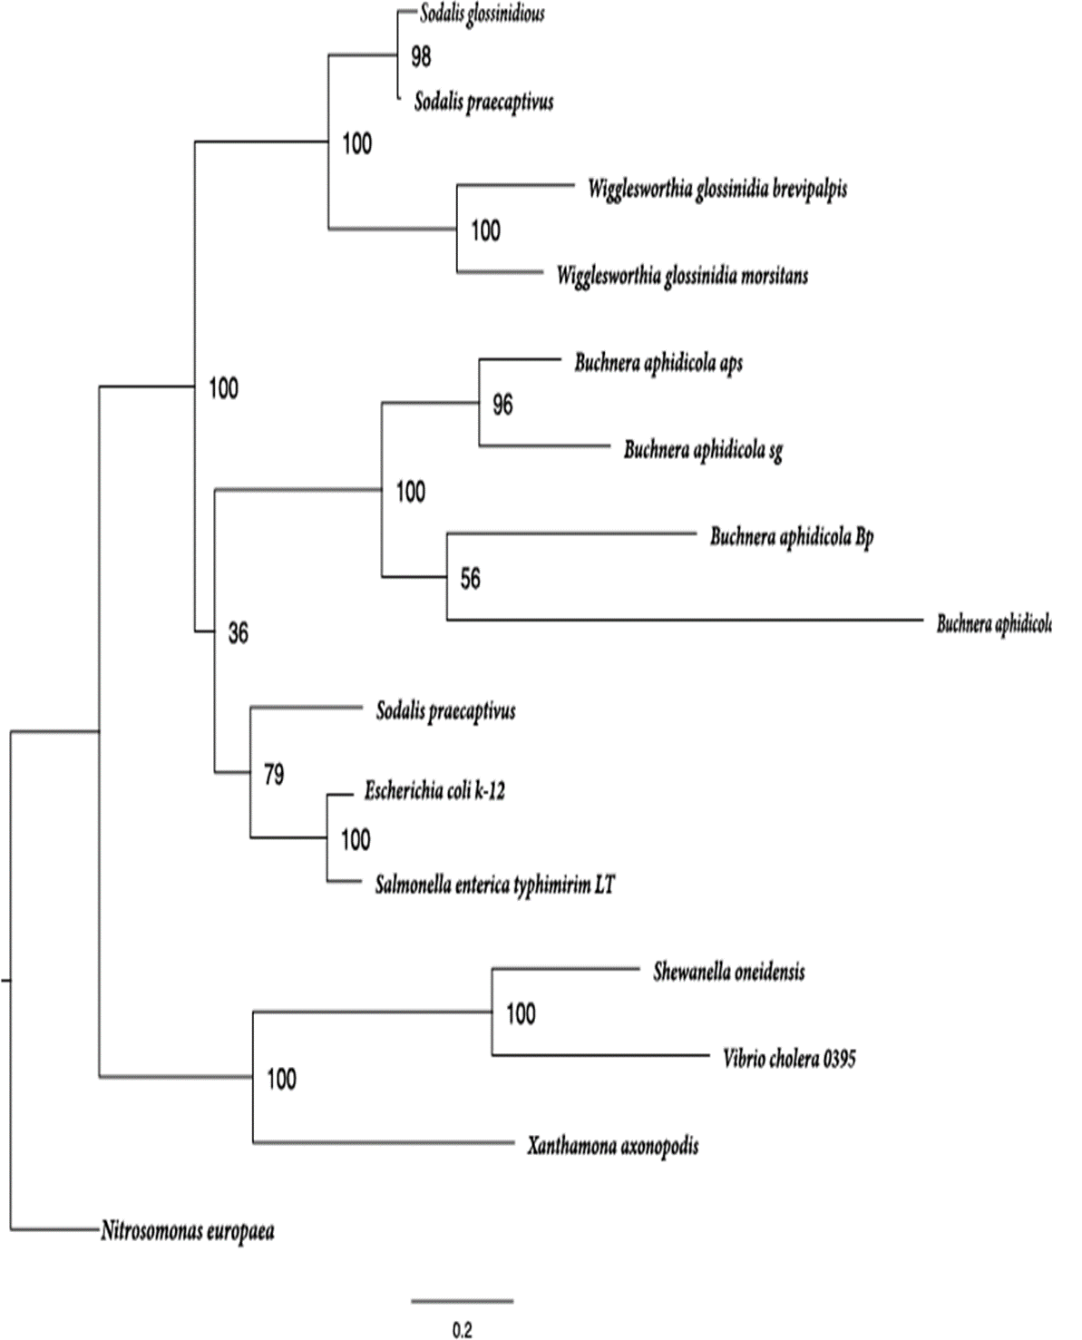

FliF RAxML protein tree. 1000 Bootstraps.
Blossum62

Slide 23
Aim 2
To discern host impact towards Sodalis-allied genomes relative to flagellar evolution.
H
That organisms that have evolved from the same progenitor likely differ in genetic capabilities as a result of environmental conditions as opposed to genetic drift.

Slide 24
Remember that well Conserved fliE-R operon? Not so… Sodalis-allied clade.

Slide 25
Differences between Sodalis-allied species flagellar pathway

Slide 26
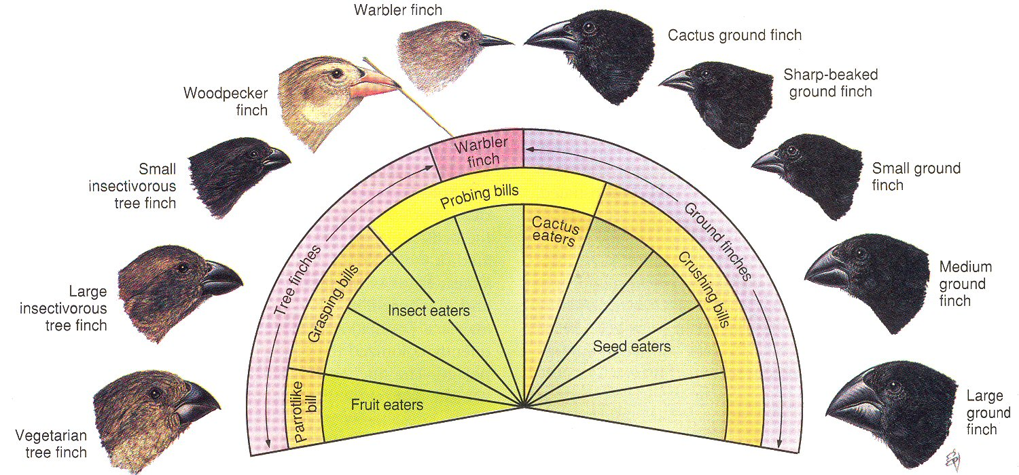
Like Darwin, we will look at selection: Using 2 Approaches
+/-
dN/dS
https://www.mun.ca/biology/scarr/Adaptation_in_Darwins_Finches.html

Slide 27
Conclusion
2 Parts to my project
Within host comparison
Between host comparison
Show that the host filter plays a trackable role in selection and conservation of molecular tools within endosymbionts

Slide 28
Thank you
Rita Rio
Miguel Medina
Mason Lee
Noah Spencer
Ying Zhang
Tim Driscoll
Craig Barrett
All of my lab mates who have helped me to this point

Slide 29
Citations
Paulk, Angelique Christine, Stefano Colella, Nicolas Parisot, Pierre Simonet, Karen Gaget, Gabrielle Duport, Patrice Baa-puyoulet, Yvan Rahbé, Hubert Charles, and Gérard Febvay. 2018. “Bacteriocyte Reprogramming to Cope With Nutritional Stress in a Phloem Sap Feeding Hemipteran , the Pea Aphid Acyrthosiphon Pisum” 9 (October): 1–18.
Kariithi, Henry M, Irene K Meki, Daniela I Schneider, Linda De Vooght, Fathiya M Khamis, Anne Geiger, Guler Demirba, et al. 2018. “Enhancing Vector Refractoriness to Trypanosome Infection : Achievements , Challenges and Perspectives” 18 (Suppl 1): 3–15.
https://www.mun.ca/biology/scarr/Adaptation_in_Darwins_Finches.html
Nikoh, N., Hosokawa, T., Moriyama, M., Oshima, K., Hattori, M., & Fukatsu, T. (2014). Evolutionary origin of insect-Wolbachia nutritional mutualism. Proceedings of the National Academy of Sciences, 111(28), 10257–10262. https://doi.org/10.1073/pnas.1409284111
http://www.biologydiscussion.com/bacteria/the-diagram-of-bacterial-cell-microbiology/63872
Appelt, Sandra, and Klaus Heuner. 2017. “The Flagellar Regulon of Legionella — A Review” 7 (October): 1–13.
Furuya, E Yoko, and Franklin D Lowy. 2006. “Antimicrobial-Resistant Bacteria in the Community Setting” 4 .
Voordeckers, Karin & Verstrepen, Kevin. (2015). Experimental evolution of the model eukaryote Saccharomyces cerevisiae yields insight into the molecular mechanisms underlying adaptation.

Slide 30
Questions?

Slide 31
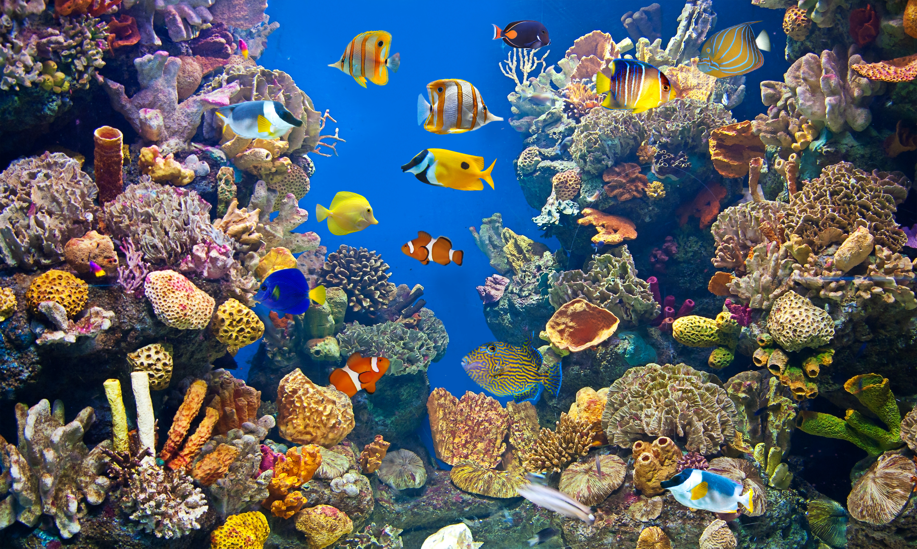
Various Environmental Constraints
Citation: Igrats prats
Notes:
Various environmental constraints play a major role in determining ecological composition. Abiotic and Biotic facters. IE. Ecological niche’s and available abiotic nutrients from the surroundings

